Slide 1


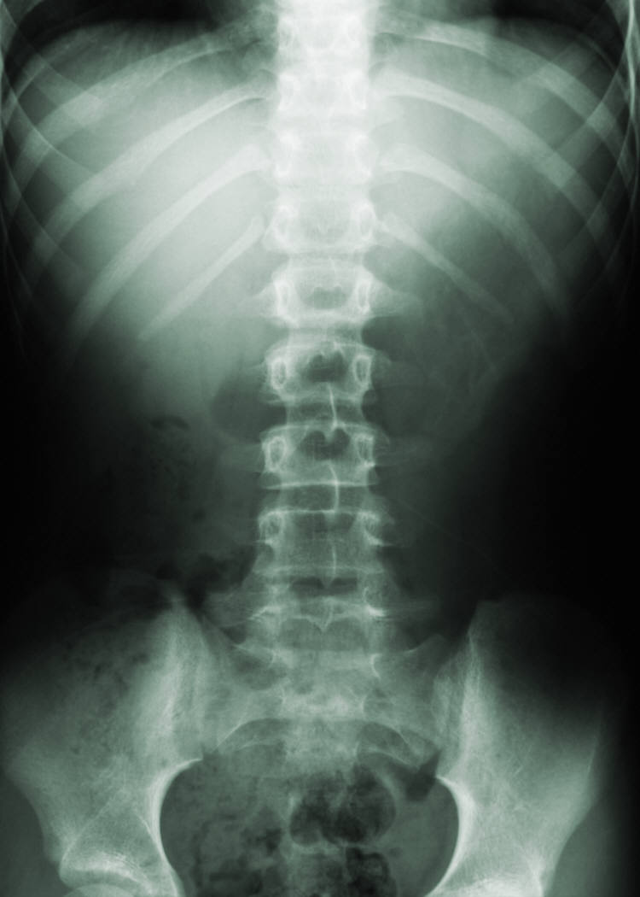
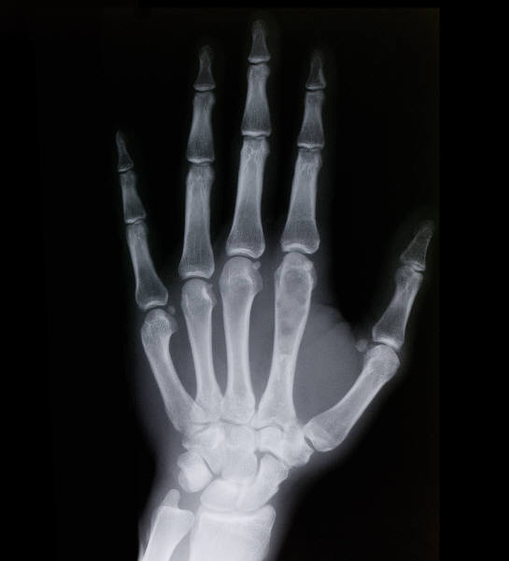

[Poster Title] Graduation Project Name
Student1 Name, Student2 Name, Student3 Name, and Supervisor Name* Department Name, Faculty of Computers and Information, Mansoura University, Egypt.
abstract
System Architecture
Results/ Users Benefits
abstract is here with no bullets and what happens when I add bullets/
If you have results, you can describe it here, otherwise describe your system benefits for end users.
background
Methods/technologies
Business Model/system cost
Add title if necessary. Click the B button on the home tab to add bold formatting.
Background item
Background item
Background item
List methods, algorithms, technologies, and any resources used to build this project
Describe your business plan here
Describe your system cost
 | Heading | Heading | Heading
Item | 122 | 233 | 345
Item | 759 | 856 | 290
Item | 228 | 134 | 238
Item | 954 | 875 | 976
Item | 324 | 325 | 301
Item | 199 | 137 | 186
objectives
conclusions
List objectives here
Objective 1
Objective 2
Objective 3
Conclusion 1
Conclusion 2
Conclusion 3
Type a caption for the data content or pictures here.
Notes:
To change this poster, replace our sample content with your own. Or, if you'd rather start from a clean slate, use the New Slide button on the Home tab to insert a new page, then enter your text and content in the empty placeholders. If you need more placeholders for titles, subtitles or body text, copy any of the existing placeholders, then drag the new one into place.

